Slide 1
Should We Roll Out
The Stronger Boost?
A/B Test
Analysis
Results
Yiwei Ye
Game Data Analysis | December 2025

Slide 2
The Problem
"Some levels are too hard."
— Player Feedback
:(
→
?
Frustration
Potential Churn
Solution?
Hypothesis
A stronger boost will help players succeed
without breaking the game

Slide 3
The Experiment
A
B
vs
GROUP A
GROUP B
Stronger Boost
Original Boost
Timeline
Jan - May 2020
June - Sept 2020
Oct - Dec 2020
Baseline
A/B TEST
Reset & Monitor
14K
1.5M
4 Mo
Players
Level Attempts
Test Duration

Slide 4
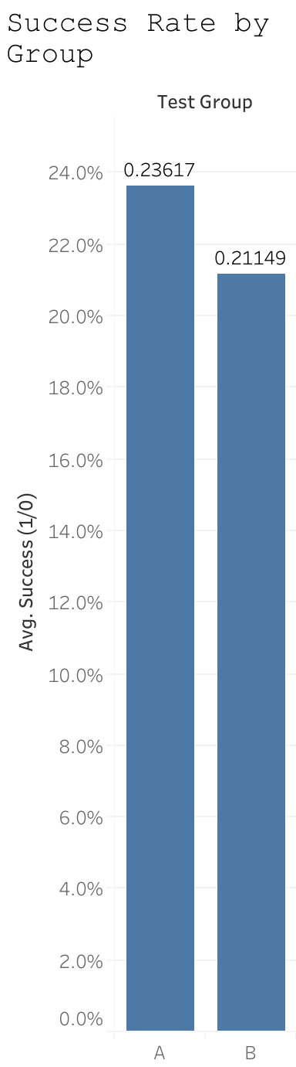
The Result
+2.6%
higher success rate
Group A
Group B
25.1%
22.5%
p < 0.001 — Statistically Significant

Slide 5
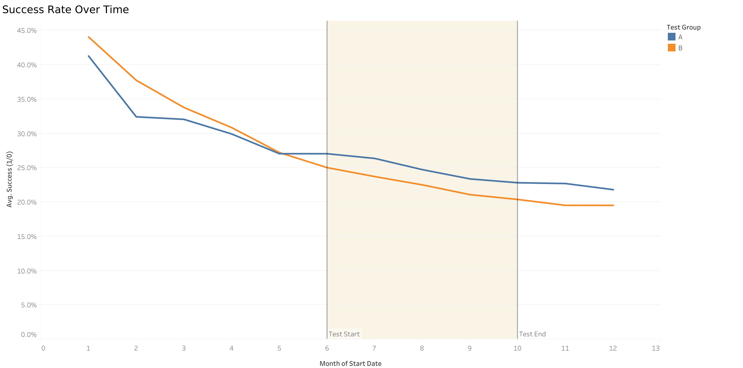
The Effect Over Time
Key Observations
Before
Groups similar
During
Clear separation
After
Effect persists!
The effect persisted even after the boost was reset!

Slide 6
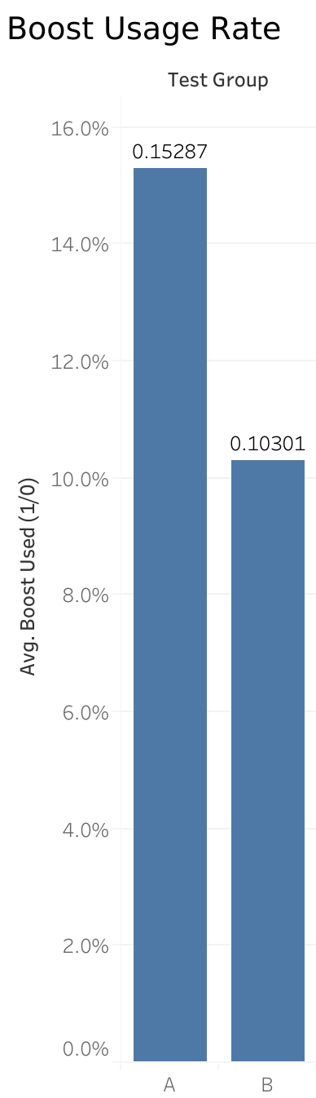
Players Love It
+51%
more boost usage
Group A
Group B
15.6%
10.3%
Players recognize value and
actively use the feature more

Slide 7
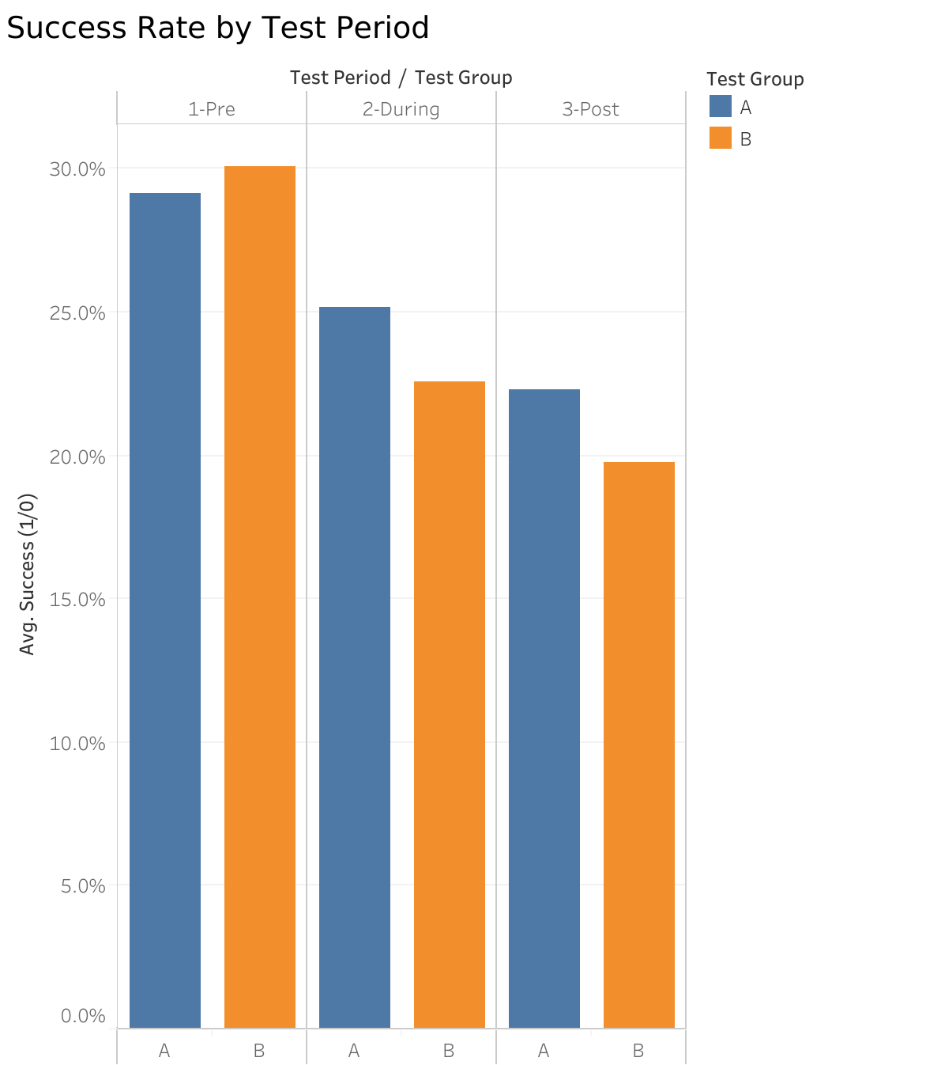
The Full Picture
PRE-TEST
A: 29.1% vs B: 30.1%
-1.0 pp (similar baseline)
DURING TEST
A: 25.1% vs B: 22.5%
+2.6 pp improvement
POST-TEST
A: 22.3% vs B: 19.7%
+2.6 pp (effect persists!)
Key Insight: Effect persists = Learned behavior / Habit formation

Slide 8
The Trade-offs
✓
✗
FOR ROLLOUT
AGAINST ROLLOUT
→ +2.6% success rate
→ May reduce game challenge
→ Statistically proven (p < 0.001)
→ Boost dependency risk
→ 51% higher engagement
→ Unknown monetization impact
→ Lasting positive effect
→ Small baseline difference
Benefits significantly outweigh risks with proper monitoring

Slide 9
Recommendation
ROLL IT OUT
✓
✓
✓
Proven Improvement
Higher Engagement
Lasting Effect
+2.6% success
+51% boost use
Persists after reset
With Monitoring:
Long-term retention • Monetization metrics • Difficulty balance

Slide 10
Questions?
Summary
+2.6%
+51%
✓
Success Rate
Engagement
Significant
Thank you!

